Slide 1
Enabling Cross-Origin Requests in ASP.NET Web API 2

Slide 2
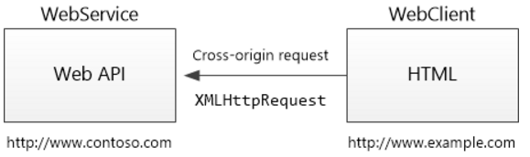
Cross-Origin-Resource-Sharing (CORS)
Browser security prevents a web page from making AJAX requests to another domain. This restriction is called the same-origin policy, and prevents a malicious site from reading sensitive data from another site. However, sometimes you might want to let other sites call your web API.
CORS is a W3C standard that allows a server to relax the same-origin policy.
Using CORS, a server can explicitly allow some cross-origin requests while rejecting others.
CORS is safer and more flexible than earlier techniques such as JSONP.

Slide 3
CORS - Demo
Create Simple Web API Service Project
Example http://apiservice:9090/api/test
Create Simple MVC Client Project
Example http://apiclient:8080/home/index
Let MVC Client make a AJAX request to API service

Slide 4
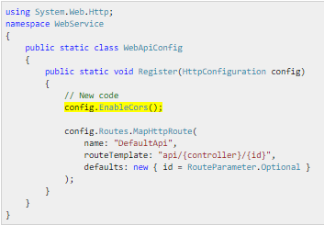
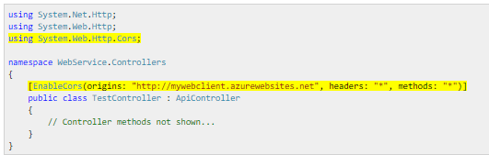
Enable CORS in API Service
Install-package Microsoft.AspNet.WebApi.Cors
Enable Cors in App_Start/WebApiConfig.cs
Or Enable Cors in Client Controller Class

Slide 5
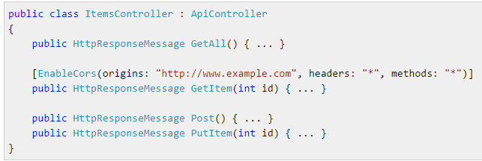
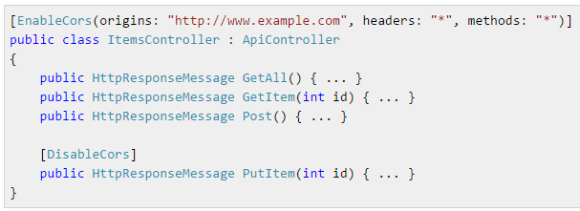
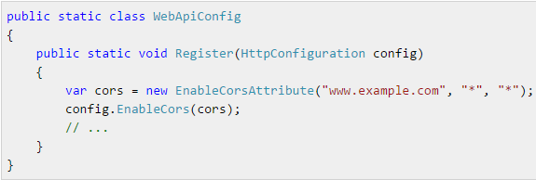
Enable CORS in Web API Service
Per Action
Per Controller
Globally

